Slide 1


HUM 102 Report Writing Skills
Lecture 19

Slide 2

Previous Lecture
Email Structure
Dos and Don’ts
Vocabulary and Useful Expressions

Slide 3




Letter Writing
Introduction
Communicate with people at distance
Discuss matter of common concern
Maintain good relations
Record of information

Slide 4

Letter Writing
Purpose
Keep in touch
Job application
Enquiries
Convey information
Complaints
Business Transactions

Slide 5

Letter Writing
Advantages
Nothing needed to receive a letter
Permanent physical record of communication
Difficult to falsify because of an individual’s signature or the notepaper of a workplace
Hand-written letter becomes more interactive and personal
Enclosure of small objects
Free from all malwares and viruses
Improvement of writing skills

Slide 6
Letter Writing
Formal Letter
Informal Letter

Slide 7
Letter Writing
Informal Letter
Also called Personal letters
Friendly style
Addressed to family and friends
Divided into following sections:
Heading
Salutation
Body
Subscription
Signature

Slide 8
Letter Writing
Informal Letter: Format [1/4]
Heading
Sender’s address (top right hand corner of the letter)
Date
No full stops
Salutation
Greetings
Dear followed by the name of friend/fellow
Followed by a comma

Slide 9
Letter Writing
Informal Letter: Format [2/4]
Body
Opening sentence: “I am writing to you after a long time, lovely to hear from you.”
Main message – brief messages written in a conversational manner
Closing sentence – express regards and hopes of a writer: “Please give my regards to…, I am looking forward to hearing from you.”

Slide 10
Letter Writing
Informal Letter: Format [3/4]
Subscription
Varies depending upon the nature and relation with the addressee
Your affectionate daughter/son, or Yours affectionately/lovingly (for relations)
Yours sincerely (for friends)
Yours is a possessive, no apostrophe

Slide 11
Letter Writing
Informal Letter: Format [4/4]
Signature
Signature/writer’s name right below the subscription
P.S. or Post Script: To add information when the writer has already signed off
R.S.V.P.: To extend invitation which requires a response

Slide 12
Letter Writing
Formal Letter
Also known as official or business letters
Official letters: to individuals holding official positions
Institutes and governments departments
Receiver’s address included within a official letter
Short and direct in business setting (less time)
Subject/reference line

Slide 13
Letter Writing
Formal Letter: Format [1/3]
Heading
Sender’s complete address followed by the name
Inside Address
Details of the person being addressed alongside name of the company/organization
Salutations/Greetings
Varies depending upon the acquaintance. E.g., If the addressee is new to you then, “Dear Sir/Madam”, “Sir/Madam”, etc.
If the addressee is someone known to you then, “Dear Mr. Naeem”, “Dear Ms. Minhas”, “Dear Mrs. Kashif”, etc.

Slide 14
Letter Writing
Formal Letter: Format [2/3]
Subject
Introduction of topic of a letter
Brief single sentence
Body
Introduction, main message, conclusion
Complimentary Closing/Subscription
Depends on salutation used. E.g., in case of an addressee not known to you, it will be “ Yours faithfully,”
In case of an addressee known to you then, “Yours sincerely,”

Slide 15
Letter Writing
Formal Letter: Format [3/3]
Signature
Under the complimentary closing
Sender’s name and designation
Enclosure (Abbreviation: Encl.)
Additional document with letter
Listed after the signature
Carbon copy (Cc): Includes the name of all the individuals receiving a copy of letter
Cc written after Enclosure

Slide 16
Letter Writing
Basic Letter Formats
Block Format
All elements on left-hand margin
Typed quickly
Modified Block Format
Two exceptions only
Date and closing on right hand side

Slide 17
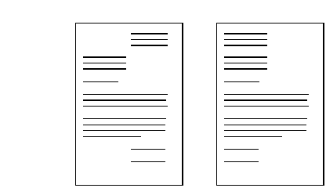
Letter Writing
Block Format
Most common layout of a business letter
Entire letter is left, justified and single spaced
Double spacing between paragraphs only

Slide 18
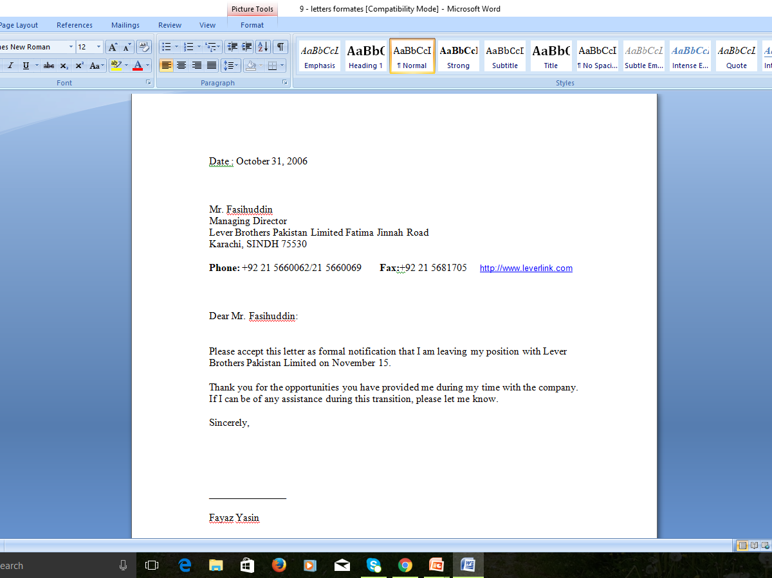
Sample:
Block
Format
Letter

Slide 19
Letter Writing
Modified Block Format
Same as the Block Format
The only exception is that closing and Date is placed on the right side

Slide 20
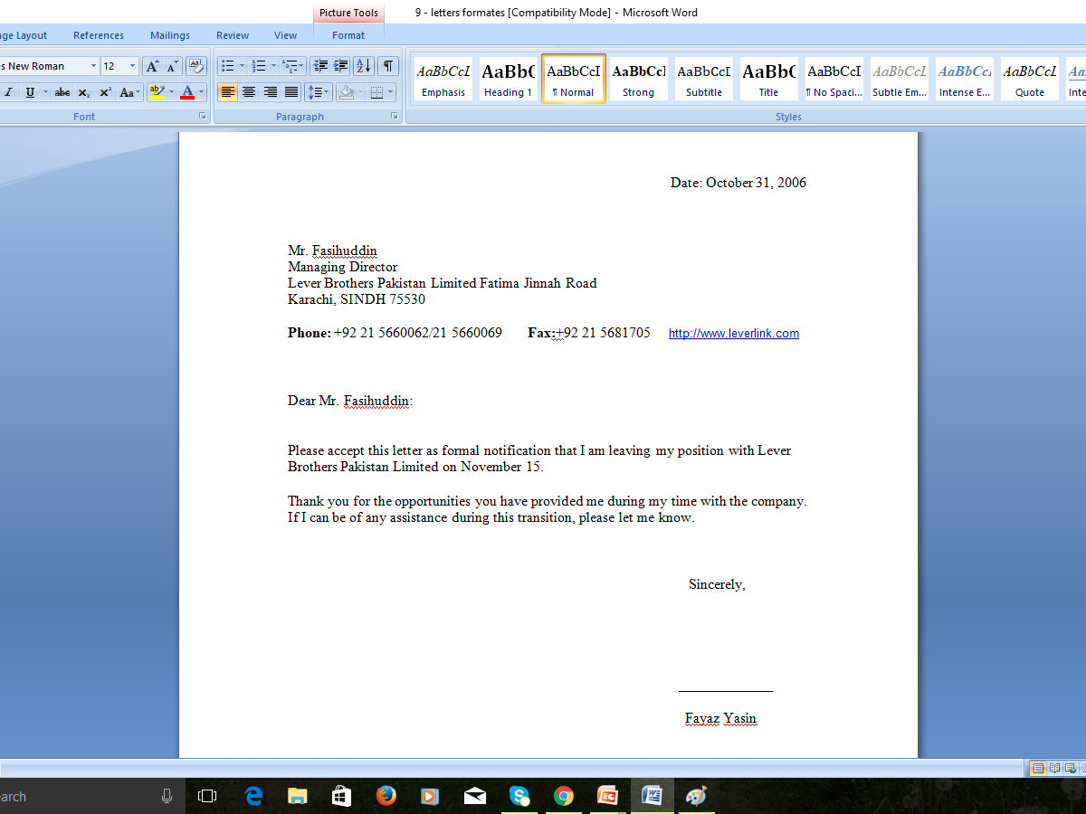
Sample:
Modified
Block
Format
Letter

Slide 21
Letter Writing
Guidelines
Provide factual information
State your message with clarity
Avoid the use of slangs
Avoid grammatical errors
Be respectful by using a polite tone in letter writing

Slide 22
Letter Writing
Kinds of Letter
Inquiry Letter
Complaint Letter
Cover Letter
Good News Letter
Bad News Letter

Slide 23
Letter Writing
Inquiry Letter [1/2]
A letter of inquiry asks someone for specific information.
In some cases, such as a request for promotional material, the recipient will have a clear interest in responding to your letter.
In other cases, such as a request for specific information on a product, the recipient may or may not be as motivated to respond quickly.
Consequently, always make the tone of the letter friendly and make it easy for the recipient to identify and provide the information you need.

Slide 24
Letter Writing
Inquiry Letter [2/2]
A letter of inquiry asks someone for specific information
Clarify your intent in the introduction
Specify your needs in discussion
Conclude precisely
Degree requirements
Equipment costs
Performance records
Or any other

Slide 25

1102 West 30th
Lawrence, KS 66321
August 4, 19XX
Dr. Maria Gomez-Salinas
Director of the Diabetes Clinic
St. David's Hospital
1000 Greenberg Lane
Wichita, KS 66780
Dear Dr. Gomez-Salinas:
I am writing you in hopes of finding out more about the new Glucoscan II blood glucose monitoring system, which a representative at Lifescan informed me that your clinic is currently using.

Slide 26
Originally, I saw Lifescan's advertisement of this new device in the January 19XX issue of Diabetes Forecast and became very interested in it. I wrote the company and got much useful information, but was recommended to write several current users of the system as well.
For a technical report that I am writing for a technical writing class at Johnson County Junior College, I need some help with the following questions:
How often does the Glucoscan II need to be calibrated in practical, everyday use conditions?
How accurate is the Glucoscan II compared to other similar systems that your patients have used?
What problems do your patients experience with this new device?

Slide 27
The Lifescan representative indicated that your clinic is one the leaders in implementing new technology for diabetics, and therefore I am eager to hear from you. In the report I will acknowledge your contributions, and I will send you a copy of the completed report if you wish.
Thank you for your time, and I hope to hear from you soon.
Sincerely,
Anita Teller
Student, Medical Technology
Johnson County Junior College

Slide 28
Conclusions
Basics, Purposes and Advantages of Letter Writing
Formal vs. Informal Letters
Inquiry Letter

